Slide 1
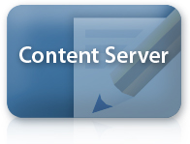
What is Mobility Server?
Deliver content to over 5000 devices
Formatting
Transcoding
Streaming
User Generated Content
Mobile collaboration
Subscriptions
On-demand or Push
Mobile Alerts
Broken
Subscriptions
User profiles
Device profiles

Slide 2
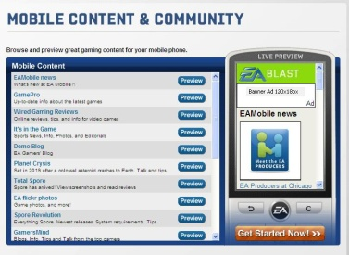
Device Content Updates
Delivery Environment
Mobility Services
Device friendly content updates
Content
User subscription
Content and Rules
Subscriptions
Device profiles

Slide 3
Targeting Mobile Visitors
Delivery Environment
Deliver targeted response
Cached targeted XML
Render content for device
Profile based targeting

